Slide 1

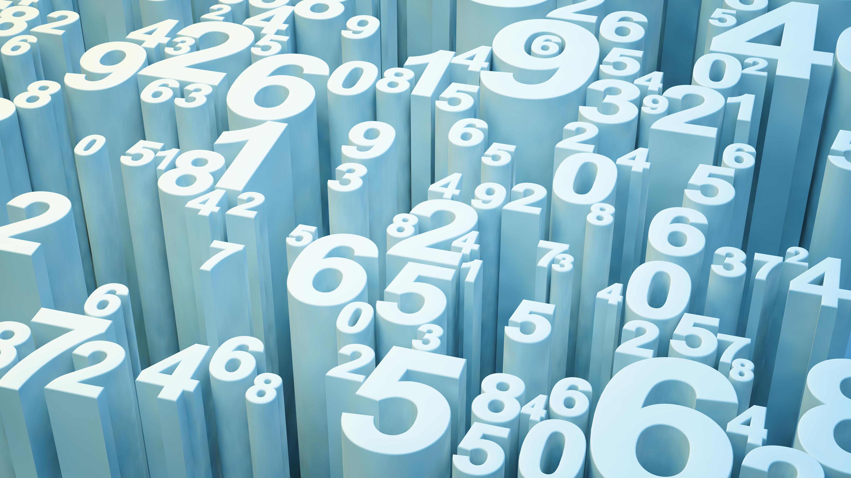
Term1 & Term2 – EDA Project on Wine Quality Analysis
Girish Kumar Sahu

Slide 2
“Wine is the most healthful and most hygienic of beverages “
– Louis Pasteur

Slide 3
Agenda
Introduction
Problem Exploration
Exploratory Data Analysis
Summary

Slide 4
Introduction
Wine quality is determined by price or region or type of grapes?
There are 600+ type of grapes available
Wine quality assessment is usually done by human experts but also via physicochemical lab test which considers various chemical properties.
Such as acidity, sugar, pH level etc.
This EDA project aims to determine which features are best quality indicators and generate insights into each of these factors.
Using pandas, matplotlib, seaborn

Slide 5

Problem Exploration

Slide 6
What is Wine Quality?
What feature determine wine quality?
What does wine company ensure to maintain quality?
What ingredients are best for a high-quality wine?
What is the way wine quality can be tested?

Slide 7
Features which classify wine quality
volatile acidity : Volatile acidity is the gaseous acids present in wine.
fixed acidity : Primary fixed acids found in wine are tartaric, succinic, citric, and malic
residual sugar : Amount of sugar left after fermentation.
citric acid : It is weak organic acid, found in citrus fruits naturally.
chlorides : Amount of salt present in wine.
free sulfur dioxide : So2 is used for prevention of wine by oxidation and microbial spoilage.
total sulfur dioxide
pH : In wine pH is used for checking acidity
density
sulphates : Added sulfites preserve freshness and protect wine from oxidation, and bacteria.
alcohol : Percent of alcohol present in wine.

Slide 8


Exploratory Data Analysis
Using Python

Slide 9
Exploratory Data Analysis
According to Wikipedia, exploratory data analysis (EDA) is an approach to analyze data sets to summarize their main characteristics, often with visual methods.
Visual representation helps humans to inspect and understand better.
Humans process visual inputs better and faster than all other types of inputs.
This is the key reason for visualizing data.
When the representation of data is pictorial it’s easier to find patterns, digest the data and develop insights to solve the problems.

Slide 10
Exploratory Data Analysis
There are various packages available in Python for visualization purpose. Some of them are: matplotlib, pandas, seaborn, bokeh, plotly, etc.
Each package has its own utility and which package to use depends mainly on the type of dataset, problem to solve and what you want to infer from it.
For this EDA project we will mainly use matplotlib, pandas and seaborn. The pandas library is the core library for Python data analysis.

Slide 11
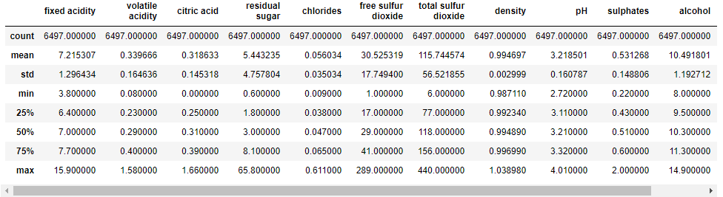
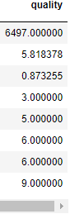
Exploratory Data Analysis
Using describe() method it provides following insights into the data
fixed acidity, citric acid, density, pH, sulphates and alcohol column is having an almost normal distribution
The max value of residual sugar, free sulfur dioxide and total sulfur dioxide is an outlier

Slide 12
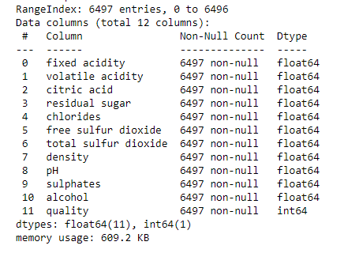
Exploratory Data Analysis
Using info() method it provides following insights into the data
No missing values in dataset
All Data type are in numeric format

Slide 13
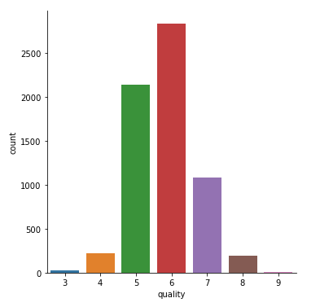
Exploratory Data Analysis
This visualization shows distribution of quality for respective feature in dataset

Slide 14
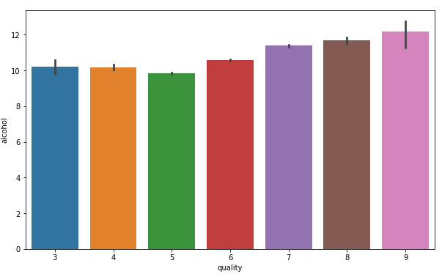
Exploratory Data Analysis
This visualization shows distribution of quality for alcohol feature in dataset

Slide 15
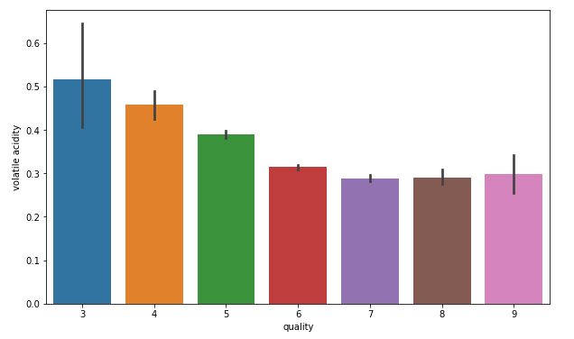
Exploratory Data Analysis
This visualization shows distribution of quality for volatile acidity feature in dataset

Slide 16
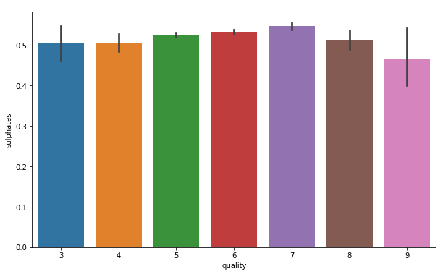
Exploratory Data Analysis
This visualization shows distribution of quality for sulphates feature in dataset

Slide 17
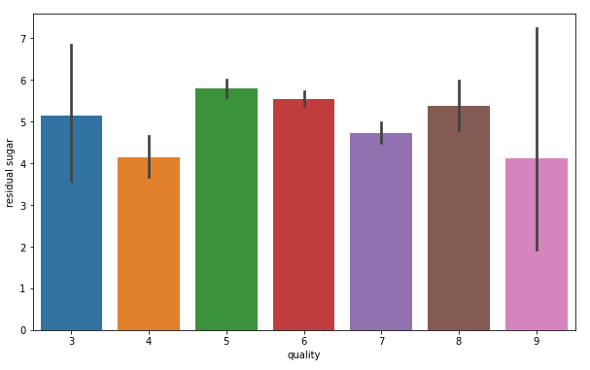
Exploratory Data Analysis
This visualization shows distribution of quality for residual sugar feature in dataset

Slide 18
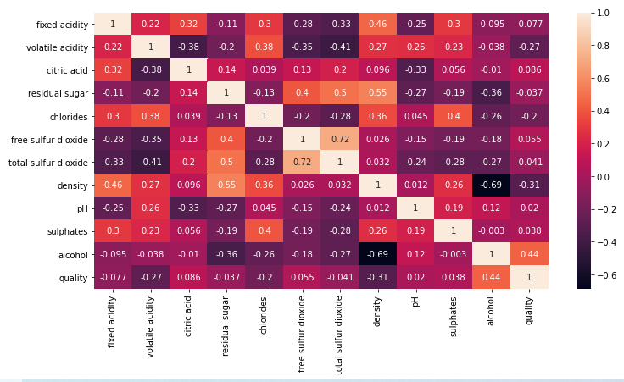
Exploratory Data Analysis
Heatmap visualization shows relationship of quality with features
Alcohol seems to have positive correlation with quality
Volatile acidity seems to have negative correlation with quality

Slide 19

Summary
High quality wines usually have high alcohol content.
High quality wine tends to have low volatile acidity.
High quality wine may have higher sulphates.
High quality wine contains higher residual sugar.

Slide 20

Thank you INSAID
“Learning is not attained by chance; it must be sought for with ardour and diligence.”

